Slide 1
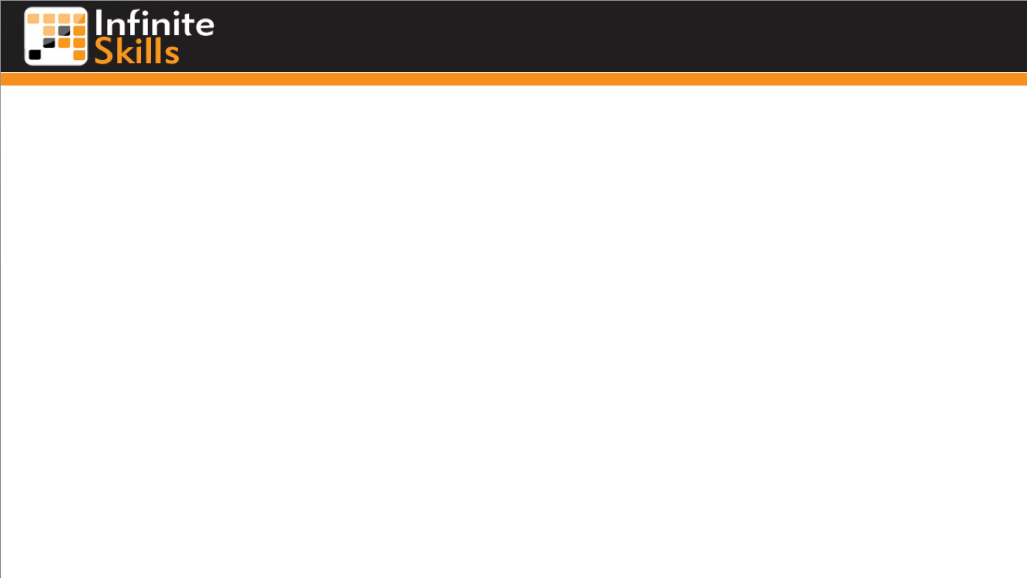
Security Considerations
Steve Perry
Email: steveperrymail@yahoo.com

Slide 2
Stop the Hackers!
User Authentication
  Your PHP Program can be called from any Web page!
  Recheck on the server-side
  Never use JavaScript for anything security related!
SQL Injection
  Non-obvious table names
    Instead of “author”, “hfe_author_5”
    Check for key words:
      Show Tables, Delete, Drop,
    Check String Lengths

Slide 3
End

Slide 4
What is a Relational Database?
A Relational Database
  Stores data in Tables
  (grid-like format, similar to a spreadsheet)
  MySQL is used for structuring, querying, and changing information in these tables
Notes:
21

Slide 5
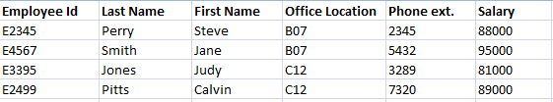
What are Tables?
They have Rows and Columns
(like a spreadsheets with rows & columns)
Notes:
23

Slide 6
End

